Slide 1

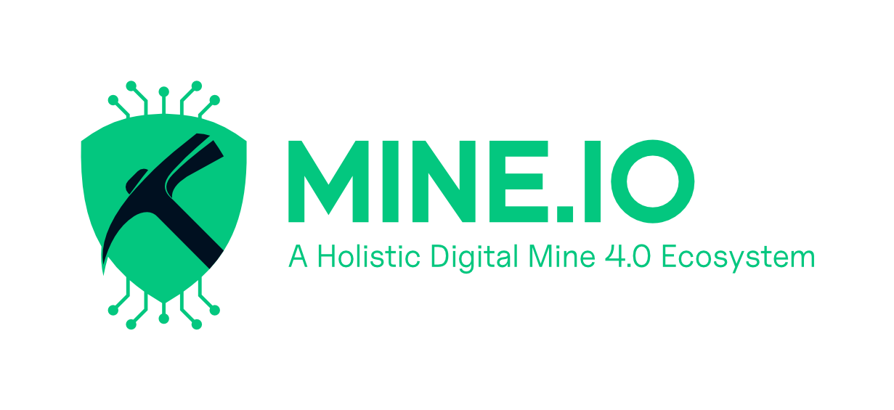

Mine.io aims to provide solutions that will build a novel mining digital ecosystem and a systemic structure for the implementation of Industry 4.0 in mining industrial environments.
HORIZON CL4 2022 RESILIENCE 01 06
Start date 01/01/2023
GA No: 101091885

Slide 2





Partners
Duration
Budget
Demonstrations
25
42 months
€ 14M
7 Pilots

Slide 3











Digitization of all mine procedures
Increase of energy efficiency and production
Workload optimization
Workflow automation
Application marketplace
Waste reduction and reuse
Environmental footprint reduction
Electification of underground trucks
mineio-horizon.eu

Slide 4
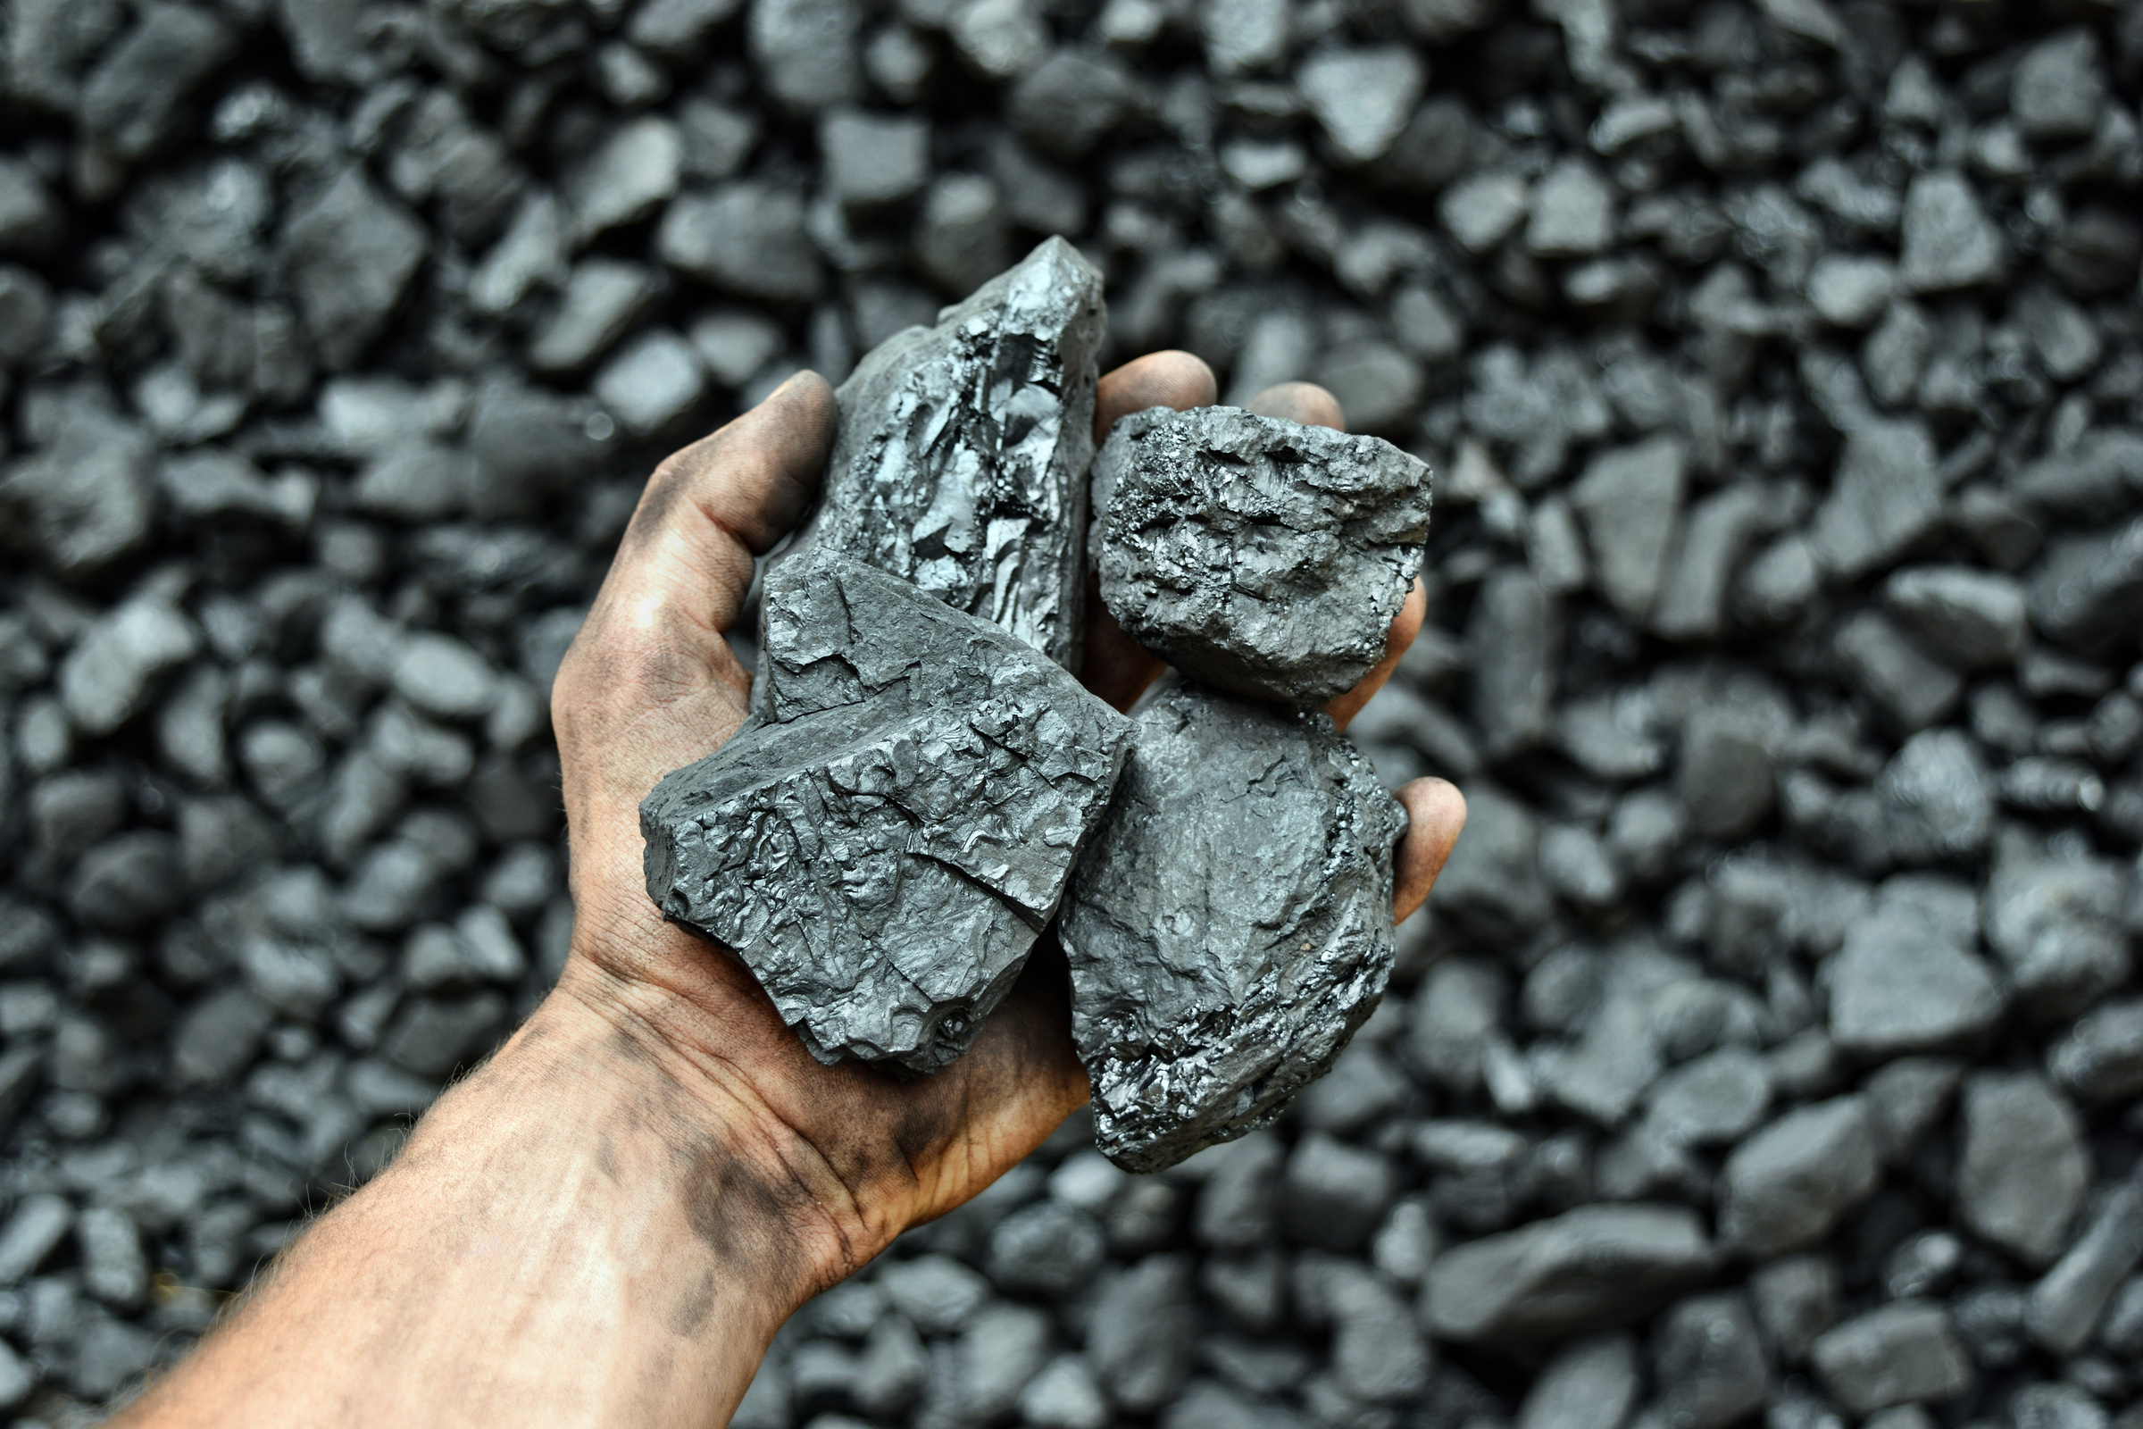





Expected Impact
Mine.io project will be energy saving and production improvement, through electrification and proces automation.
Contribute to the creation of environmentally friendly, resource-efficient, and production-efficient sustainable mining practices.
Technologies and processes focused on making the production of raw materials more automated and digitalized.
The novel digital infrastructure will embrace the technologies, facilitating openness, sharing, and collaboration.
mineio-horizon.eu

Slide 5







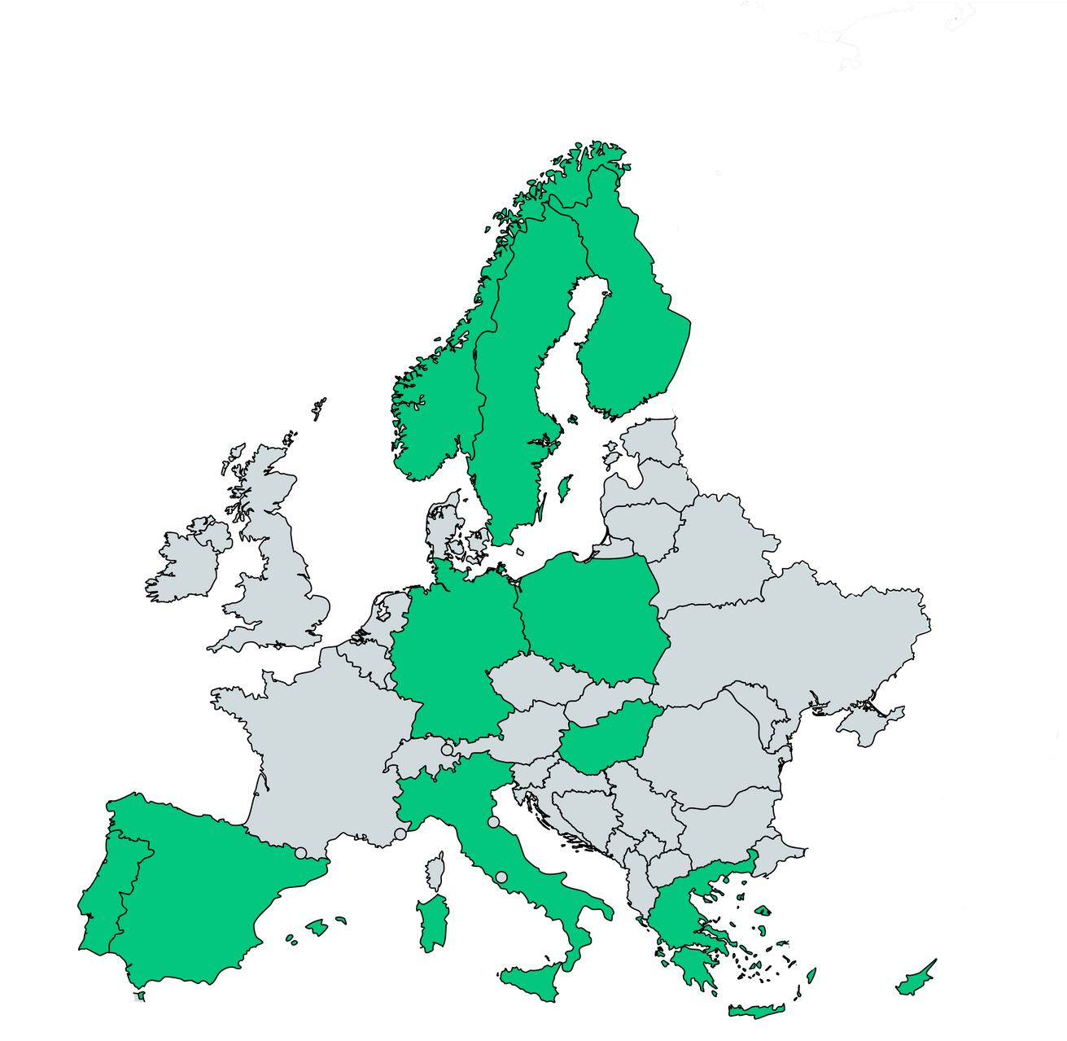




















Slide 6
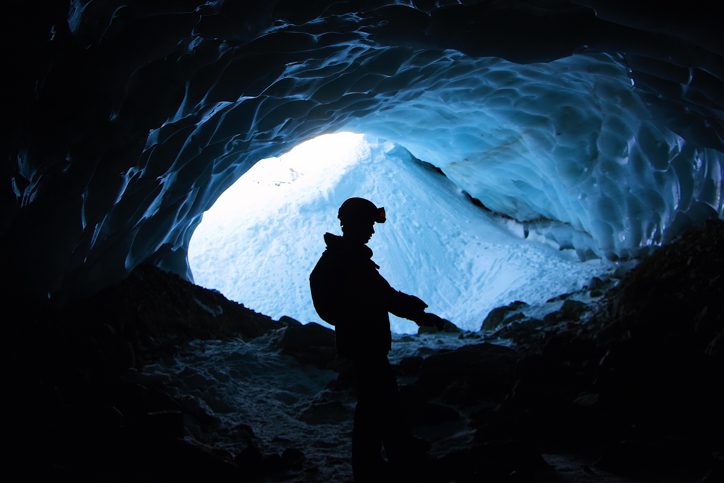
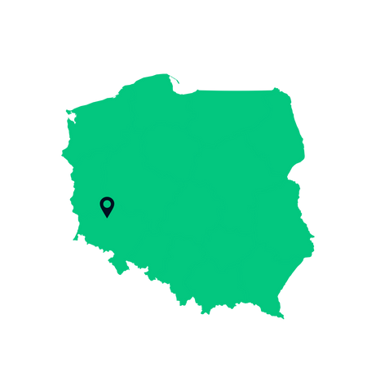
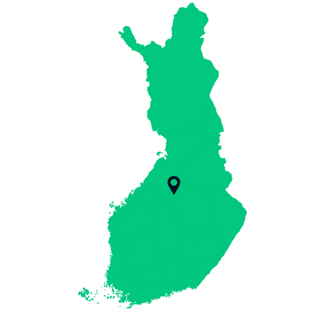
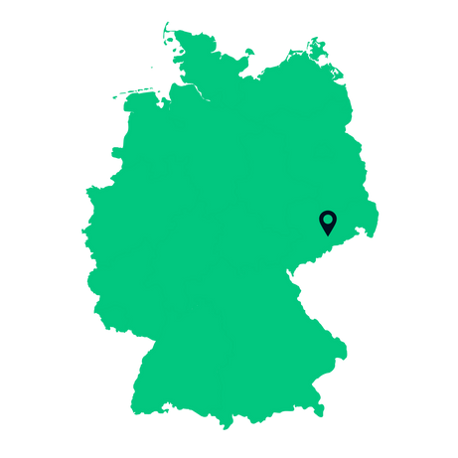



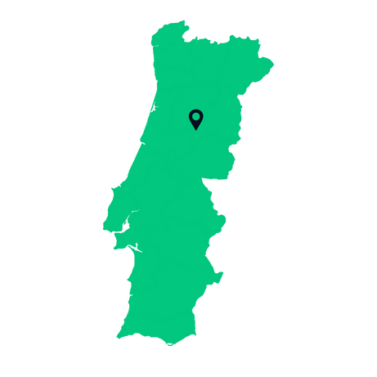
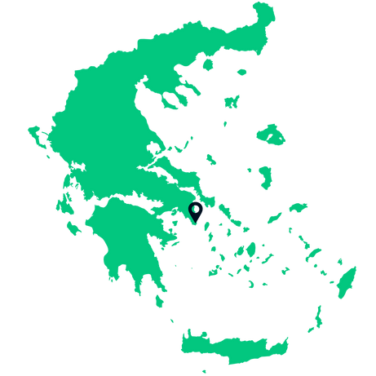


Pilot sites
ML and AI tech optimize flotation process control in mineral plants
Fusing geophysical data for tailings facilities monitoring and management
Digitalisation Drill Operations and Advanced Digital Mining Maitenance
& Digital Smelter
Ore Processing Plants,
KGHM Polska Miedź S.A.,
Polkowice, Poland
Pyhäsalmi Mine,
North Ostrobothnia,
Finland
Research and Education Mine
“Reiche Zeche”,
Freiberg, Germany
Active fluorspar mine - primary use case for electrification and automation
Underwater tech validation for mines,
UX-1Neo robot maps environments
Digital waste solutions with Muon Tech for mining environmental management
Digital TSL-Smelter at the Institute
of Nonferrous Metallurgy,
Freiberg, Germany
Oberwiesenthal, Germany
Malaposta open pit site,
Urgeiriça mine,
Portugal
Lavrion Ancient Silver Mines,
Attica Region,
Grecce

Slide 7




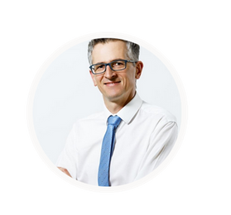


Contact us
info@mineio-horizon.eu
mineio-horizon.eu
linkedin.com/company/mineio-horizon
Marek Kościelski
Communications Manager
marek.koscielski@itr.lukasiewicz.gov.pl
x.com/mineio_horizon
facebook.com/mineio.horizon

Slide 8


Slide 9






dinamine-project.eu
mineio-horizon.eu
mastermine-project.eu
nethelix.eu

